Slide 1
INDIAN ART FORM
Unit – 1
Indian Art Over Ages!
Prepared by:
M.Sathiya, Assist. Prof,
EFL Department

Slide 2
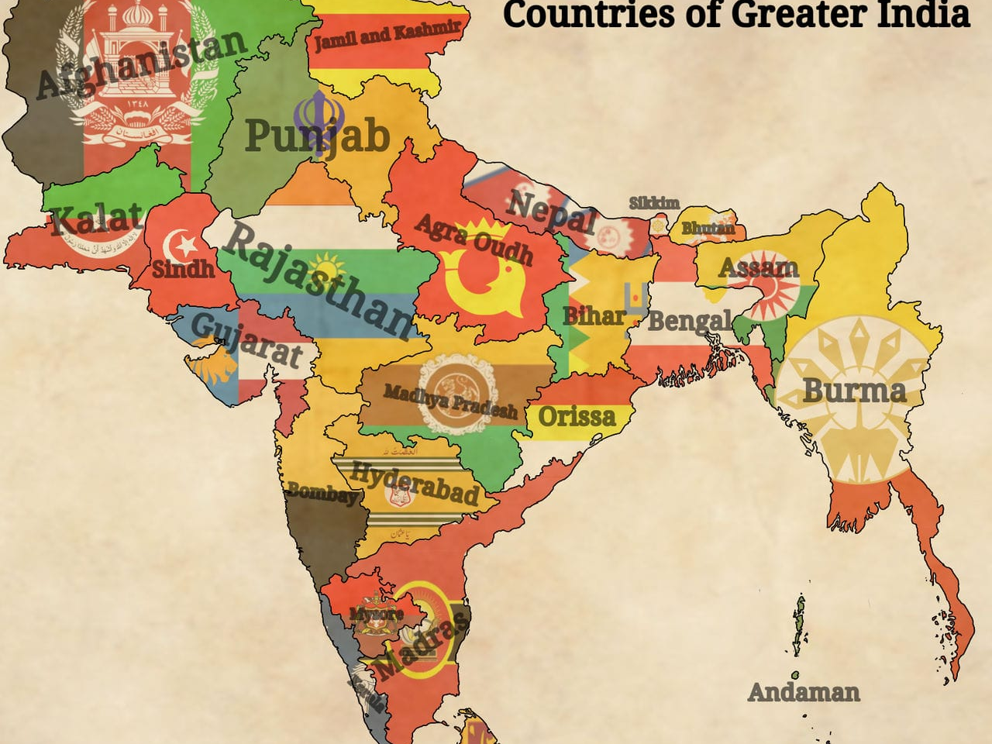

Slide 3
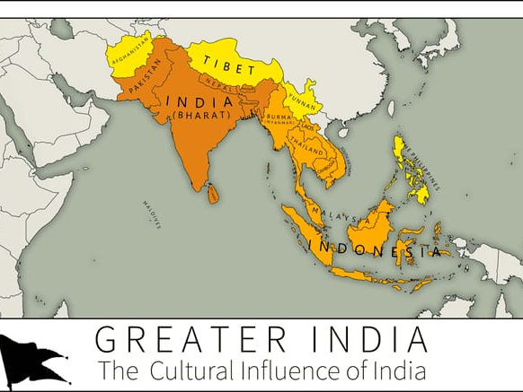

Slide 4
Ancient India – An Introduction
Ancient India is the Indian subcontinent from prehistoric times to the start of Medieval India.
Ancient India was composed of the modern-day countries of Afghanistan (some portions), Bangladesh, Bhutan, Myanmar, India and Pakistan.

Slide 5
India is one of the oldest civilizations in the world with a kaleidoscopic variety and rich cultural heritage.
It has achieved all-round socio-economic progress since Independence.
As the 7th largest country in the world
India stands apart from the rest of Asia, marked off as it is by mountains and the sea, which give the country a distinct geographical entity.

Slide 6
Geographical setting
Bounded by the Great Himalayas in the north, it stretches southwards and at the Tropic of Cancer, tapers off into the Indian Ocean between the Bay of Bengal on the east and the Arabian Sea on the west.

Slide 7
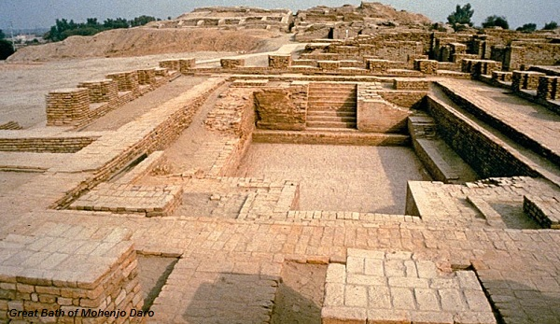
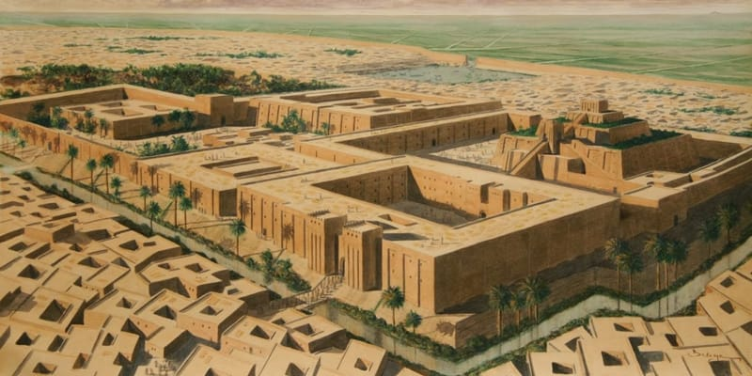
Harappan Civilization
Mesopotamian Civilization

Slide 8
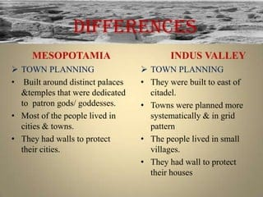

Slide 9
Indus Valley Civilization
The History of India begins with the Indus Valley Civilization and the coming of the Aryans.
These two phases are generally described as the pre-Vedic and Vedic periods.
The earliest literary source that sheds light on India's past is the Rig Veda.

Slide 10
It is difficult to date this work with any accuracy on the basis of tradition and ambiguous astronomical information contained in the hymns.
It is most likely that Rig Veda was composed between 1,500 B.C. and 1,000 B.C. In the fifth century, large parts of India were united under Asoka.

Slide 11
Paintings of Raja Ravi Varma
Date of Birth: April 29, 1848
Place of Birth: Kilimanoor, Travancore
Date of Death: October 2, 1906
Considered as one of the greatest painters in the Indian history.
Varma was patronised by Ayilyam Thirunal, the next Maharaja of Travancore and began formal training thereafter. He learned the basics of painting in Madurai.
His paintings mainly based on the Puranas (ancient mythological stories) and the great Indian epics - Mahabharata and Ramayana.

Slide 12
Ravi Varma is one of the few painters who managed to accomplish a beautiful union of Indian tradition with the techniques of European academic art.
Varma was also responsible in taking the Indian art all over the world with his impeccable technique.
Varma’s paintings highlighted the beauty of South Indian women which were admired by all.

Slide 13
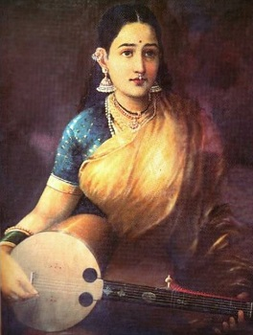
Great Paintings of Ravi Varma
A Family of Beggars – This painting represented the sorry state of Indian economics.
A Lady Playing Swarbat – Just like many of his paintings, this too, was modelled after a South Indian woman.

Slide 14
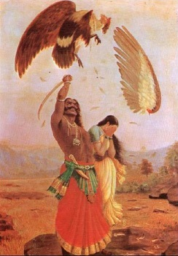
Jatayu (a bird devotee of Lord Rama) –One of the most commonly featured work of Raja Ravi Varma. The picture narrates the story of Jatayu who gives up its life after fighting the mighty villain Ravana from Ramayanam.

Slide 15
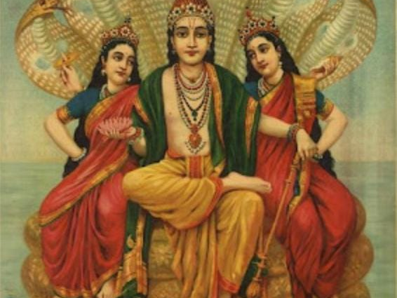

Slide 16
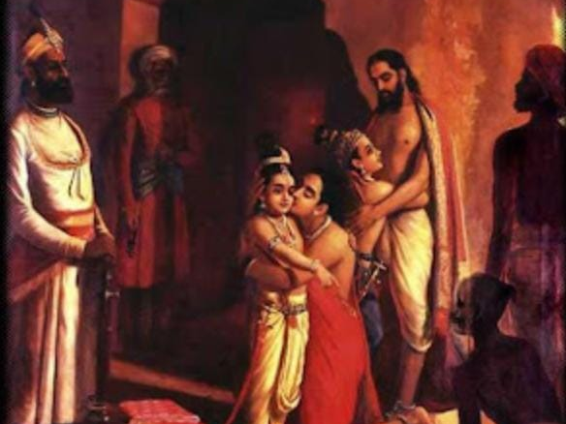

Slide 17
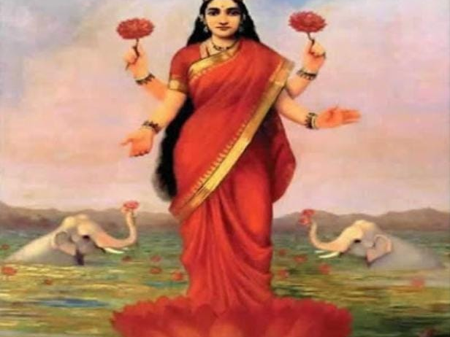

Slide 18
Tanjore Paintings – An overview
Classic south Indian style paintings.
Resources and inspirations dates back from 1600 AD.
Influenced by both Tamil and Telugu culture and art styles.
In Thanjavur paintings one can see the influence of Deccani, Vijayanagar, Maratha and even European or Company styles of painting.

Slide 19
Thanjavur paintings are panel paintings done on wooden planks, and hence referred to as palagai padam
Paintings are characterized by rich and vivid colors, simple iconic composition, glittering gold foils overlaid on delicate but extensive gesso work and inlay of glass beads and pieces or very rarely precious and semi-precious gems.
Subjects- Hindu Gods, Goddesses, saints and scenes from epics and mythologies.

Slide 20
Thanjavur glass paintings following the techniques of Chinese reverse glass paintings were popularised during Serfoji II’s reign as a cheaper and faster craft.
In the past, artists used natural colours like vegetable and mineral dyes, whereas the present day artists use chemical paints. For outlines dark brown or red was usually used.

Slide 21
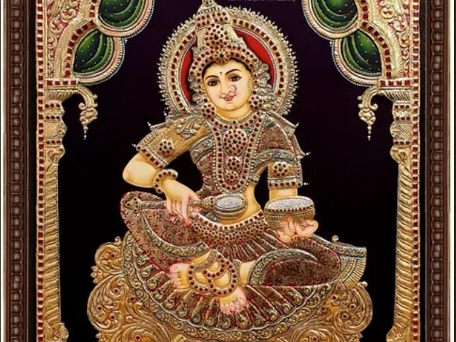

Slide 22
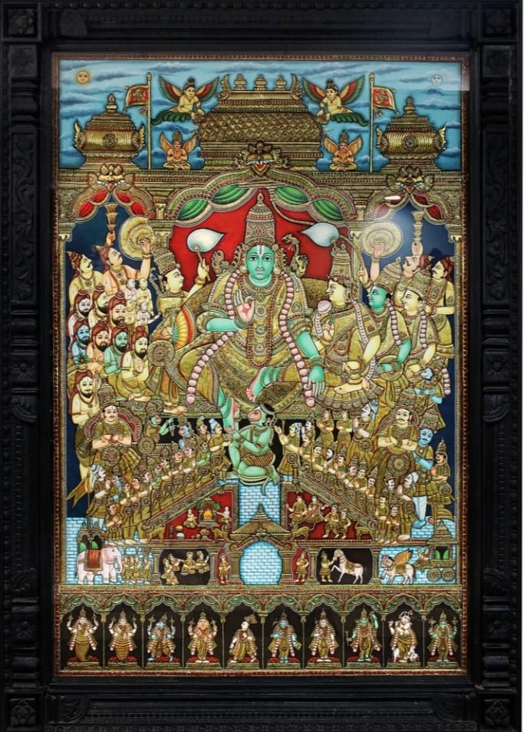

Slide 23
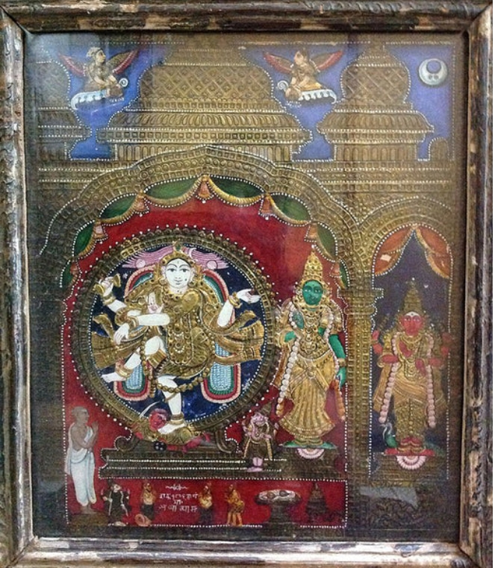

Slide 24
Mysore Paintings
Originated in the towns of Mysore, Karnataka.
The distinct school of Mysore painting evolved from the days of the Vijayanagar Empire (1336-1565 AD).
It was under the Wadiyar Dynasty patronage that Mysore school of painting touched its peak.
It is quite similar to the Tanjore Paintings.
Mysore Paintings make use of thinner gold leaves and need much more hard work.

Slide 25
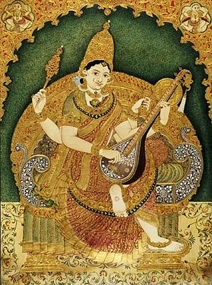

Slide 26
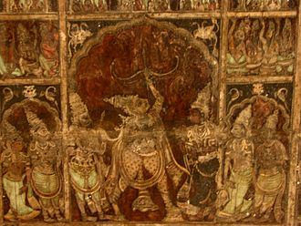

Slide 27
Indian folk arts from different fields.
Warli Folk Paintings
Madhubani Art
Saura Paintings
Bhil Art
Gond
Pattachitra Paintings
Kalamazethu Art
Khovar Art
Kavad or Kawad Art

Slide 28
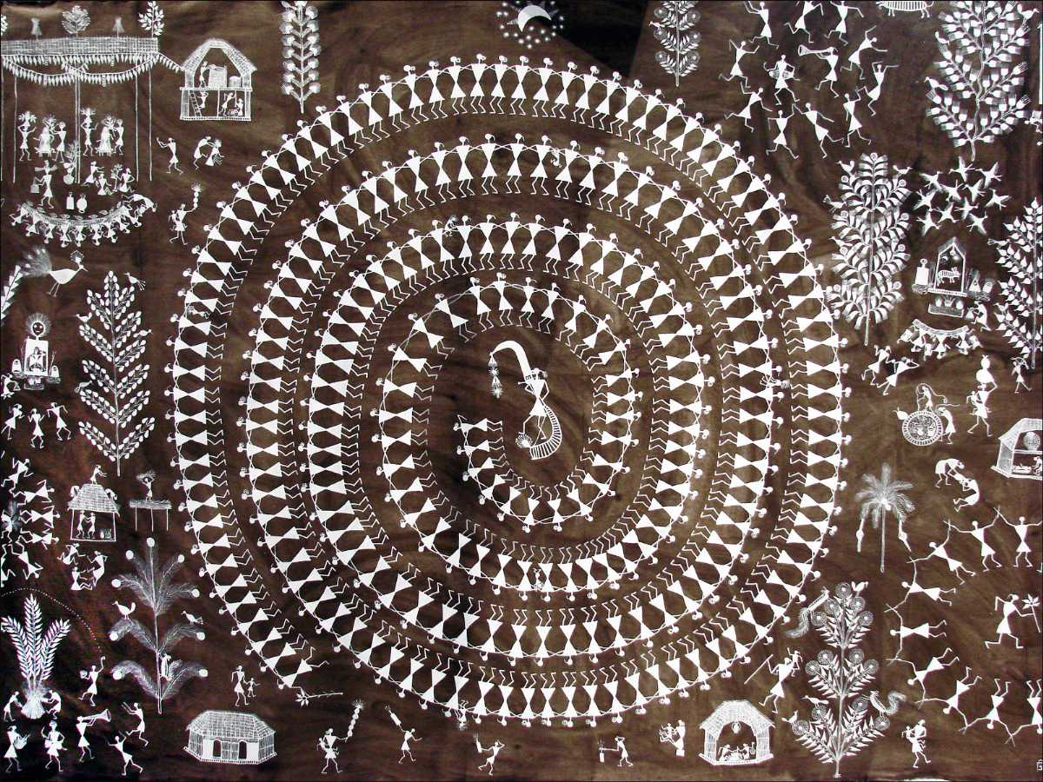
Warli Paintings.
Belonging to the state of Maharashtra, this tribal art is famous for its elementary wall paintings.
The painting portrays hunting, festivals, fishing, farming, dancing and other scenes of daily life.

Slide 29
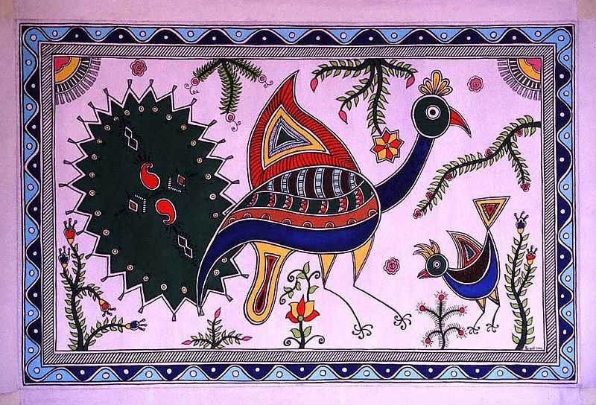
Madhubani Art
Madhubani is an Indian art formed by the women of Mithila.
Also referred to as Mithila art, it is originated from Bihar.

Slide 30
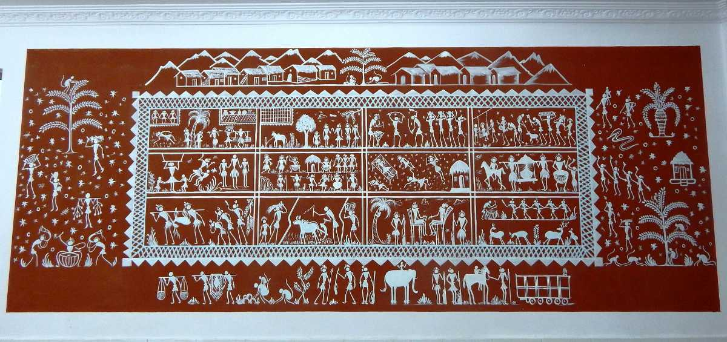
Saura Paintings
These paintings also originated from the state of Orissa but it is also found in the states of Maharashtra, Madhya Pradesh and Jharkhand. They are also called Ikons. The backdrop of the painting is prepared from red or yellow ochre which is painted using brush and bamboo.

Slide 31
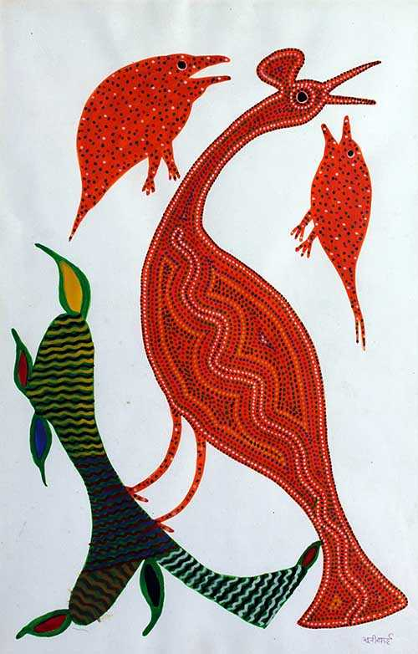
Bhil Art
Bhils are the second largest tribal community of India. Bhil art is also given by them.
Originating from the states of Madhya Pradesh, Rajasthan, Gujarat, Maharashtra. This art unveils the life of Bhils themselves.

Slide 32
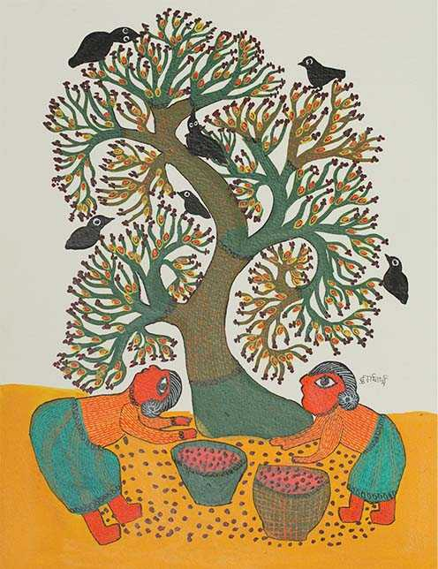
Gond
Originated from the state of Madhya Pradesh and nearby states, this art is carved on the mud walls.
Originated from the state of Madhya Pradesh and nearby states, this art is carved on the mud walls.

Slide 33
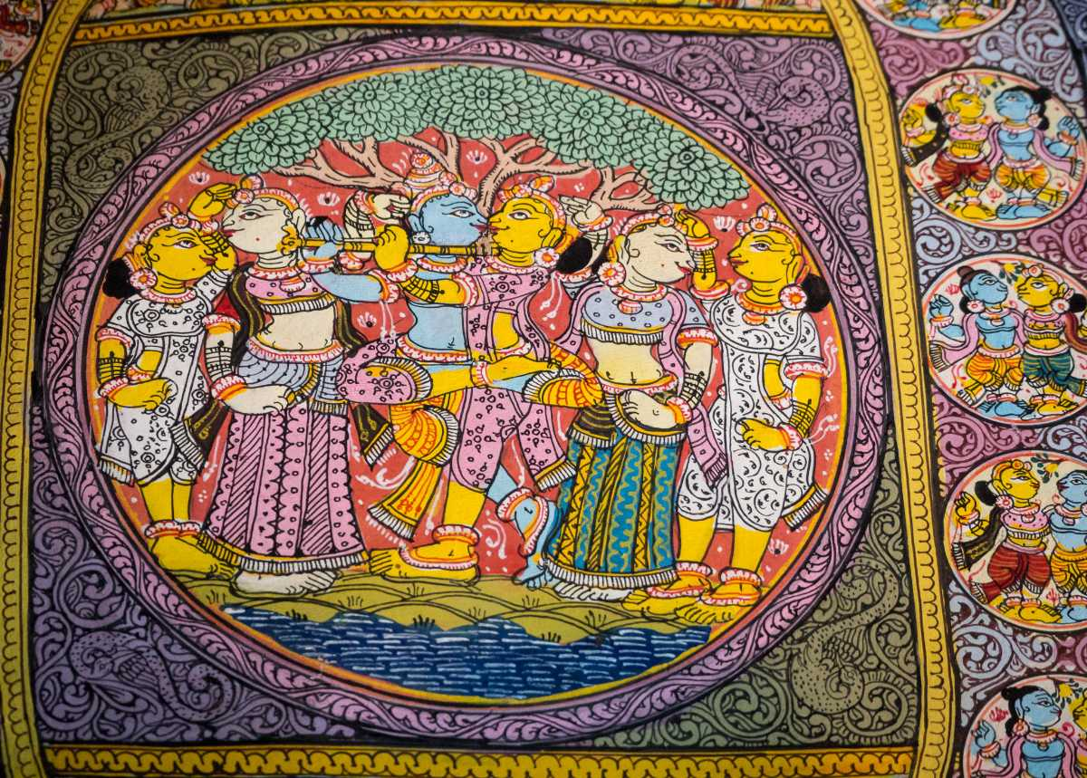
Pattachitra Painting
Pattachitra paintings are traditional paintings which originated from Odisha and West Bengal. It is a cloth-based painting which portrays Gods and Goddesses, made of sharp and fine lines in bold colours, floral designs in borders. In olden days, these paintings were used as story-telling.

Slide 34
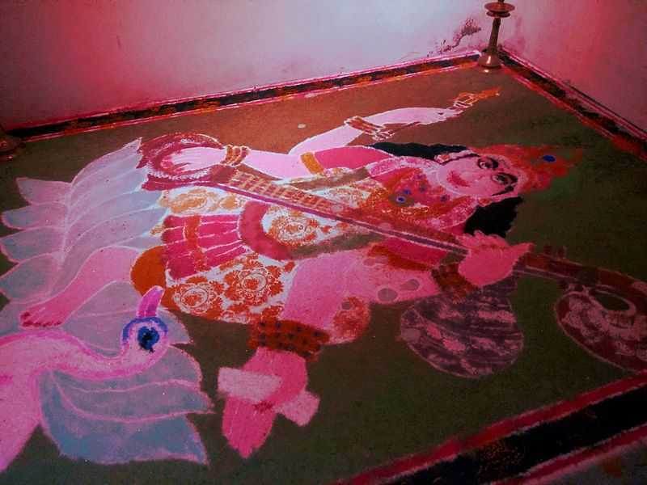
Kalamezhuthu Art
Kalamezhuthu art is a ritual art of God’s own country- Kerala.
“Kalam” means picture and “ezhuthu” means drawing.
This is a painting done on the floor and it can be seen during festivals and special occasions.

Slide 35
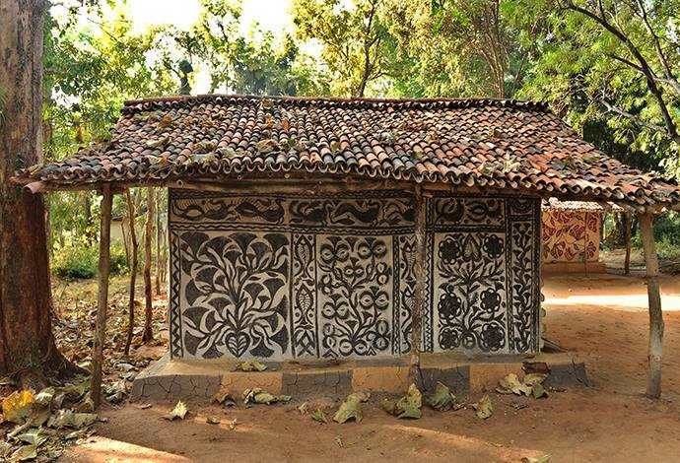
Khovar Art
Khovar art originated from Jharkhand.
Usually, tribal people living in the forest carve animals like, Tiger, Snake, Peacock, etc. while those living on plains carve Cow, Goat, Pigeon, etc.

Slide 36
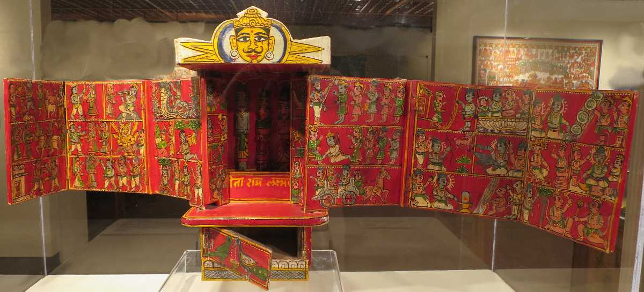
Kavad or Kawad Art
Kavad or Kawad art of Rajasthan is around 500 years old art which is practised by Jangid Brahmins of Chittorgarh. It is a three-dimensional box which has multiple panels that can be unfolded. It is a portable temple in which various Gods and Goddesses are painted.

Slide 37
THANK YOU…

